Slide 1

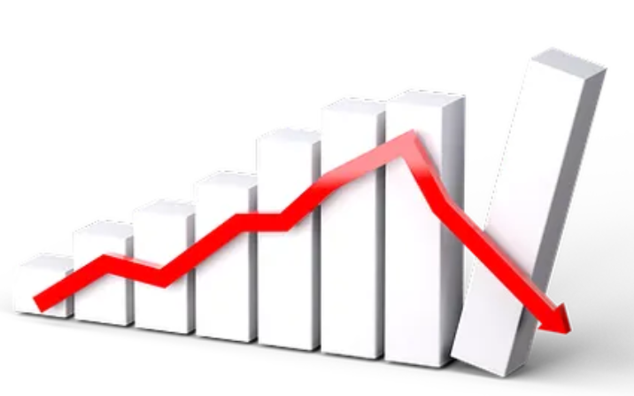
STOCK MARKET DATA ANALYSIS
- Mohammad Ibrahim
- Poonam Patil

Slide 2

INTRODUCTION
Stock market data refers to the collection of information related to stocks and their prices, as well as other financial indicators such as trading volume, market capitalization, and stock performance over time.
Investors and traders use this data to make informed decisions about buying and selling stocks, as well as to analyze market trends and predict future activity.
Stock market data can be obtained through various sources, including financial news websites, stock market indices, and financial data providers.
The data is often analyzed using various tools and techniques to gain insights into market behavior and inform investment decisions.

Slide 3
TECHONOLOGIES
Language Python, Pyspark
Environment Azure Databricks
Visualization PowerBI
Azure Services SQL Databases, Azure Data Lake Factory, Storage Accounts, Azure Databricks
DevOps Continuous Intergration and Continuous Deployment, GitHub

Slide 4
START
Index
processed
Index data
Index info
Functions
Data Validation
Data Analysis
Visualization
Driver Menu
CI/CD
Power BI

Slide 5
FUTURE SCOPE
The future scope of stock market data looks promising, with the use of advanced technologies such as artificial intelligence, machine learning, and big data analytics.
These technologies can help analyze vast amounts of data and provide valuable insights into market trends, patterns, and investor behavior.

Slide 6
THANK YOU

